Slide 1
Ultrafast Lasers
Dan Bartles, Dan Crisp
Optics I
MSU

Slide 2
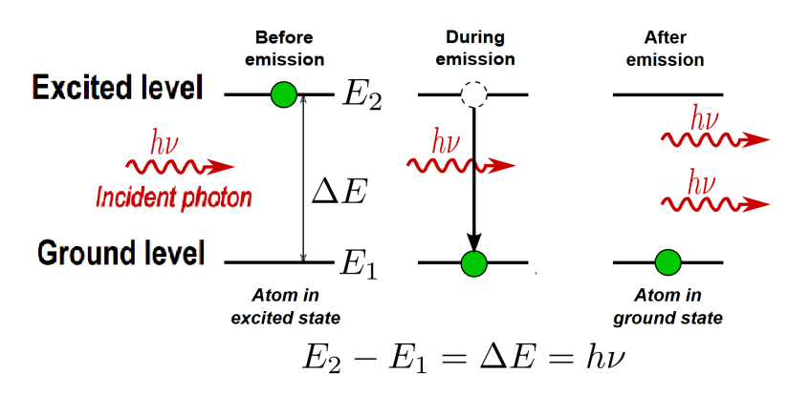
Light Amplification by Stimulated Emission of Radiation
Stimulated Emission
Population Inversion

Slide 3
Light Amplification by Stimulated Emission of Radiation
Stimulated Emission
Population Inversion
Ultrashort Pulses
Picosecond or shorter
GEKKO XII / LFEX (Osaka Uni)
Laser for Fast Ignition Experiments
Neodymium-doped glass laser
Two petawatts over one picosecond
Used to investigate extreme conditions in space

Slide 4
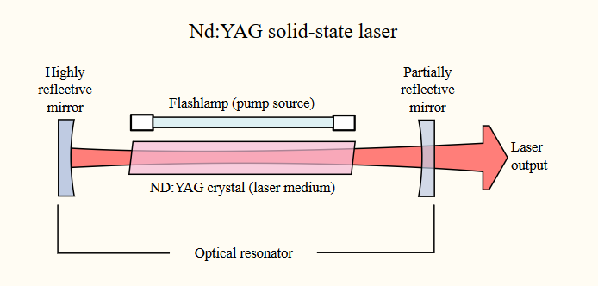
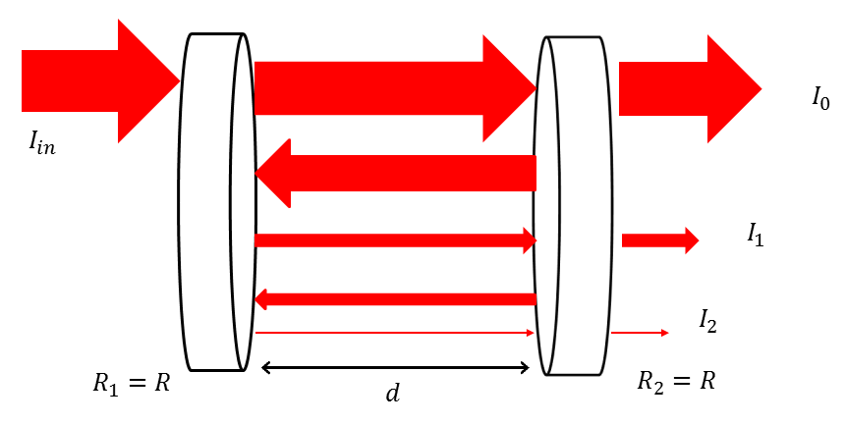
Construction of a Laser
Main components:
Pump
Produces energy needed to stimulate emission
Medium
Contains the atoms that will be stimulated
Optical Cavity
(equations)
Notes:
Pump provides energy needed to lase
Gain medium/laser medium
Optical resonator

Slide 5
Ultrashort Pulses
We would like to produce high-intensity laser pulses with duration on the order of picoseconds or shorter – “ultrashort”
Why?
………….
Two-Strategies
Q-Switching
Mode-Locking
Passive
Active

Slide 6
Ultrashort Pulses
Two-Strategies
Q-Switching
Change the physical properties of the gain medium, thereby changing the Q of the cavity
No Lasing / Large population inversion created
Return the medium to resonance, dumping energy
More energy per pulse than mode-locking
Nanosecond pulse duration doesn’t qualify as ultrashort
Mode-Locking
Superhet Design
Both give pulses much more energetic than the continuous wave

Slide 7
References
[]
[]
[] Lasers & Optoelectronics Lecture 23: Mode Locked Lasers (Cornell ECE4300 Fall 2016) https://www.youtube.com/watch?v=Jf-hQzVsLJ8
[] Lasers & Optoelectronics Lecture 24: Active and Passive Mode Locking (Cornell ECE4300 Fall 2016)
[]
[] https://phys.org/news/2015-08-world-powerful-laser-trillion-watts.html

